Slide 1
A Simple Introduction To Spring Boot
Levent Divilioglu – Jul, 2018

Slide 2
What Is Spring Boot
Spring Boot is a framework based on Spring Framework in order to create standalone applications.

Slide 3
Why Spring Boot
Easy to create standalone applications
You can create containerless web applications
No WAR files (Embedded Tomcat & Jetty)
No boilerplate code
Automatic Configuration (Web.xml is history)
No need to worry about dependencies

Slide 4
When To Use
Spring Boot is ideal for Microservices
Scalable Web Services to be used in Cloud

Slide 5
What Spring Boot Solves
We don’t have to loose time for boilerplate code
Heavy web application configuration
Configuring Web Containers
Scalability

Slide 6
What We Do Before
Configure Web.xml or Java Configuration for Web Services
Connection Pooling & Container Configuration
Container Deployment (Tomcat, JBoss)
Hibernate & ORM Configuration

Slide 7
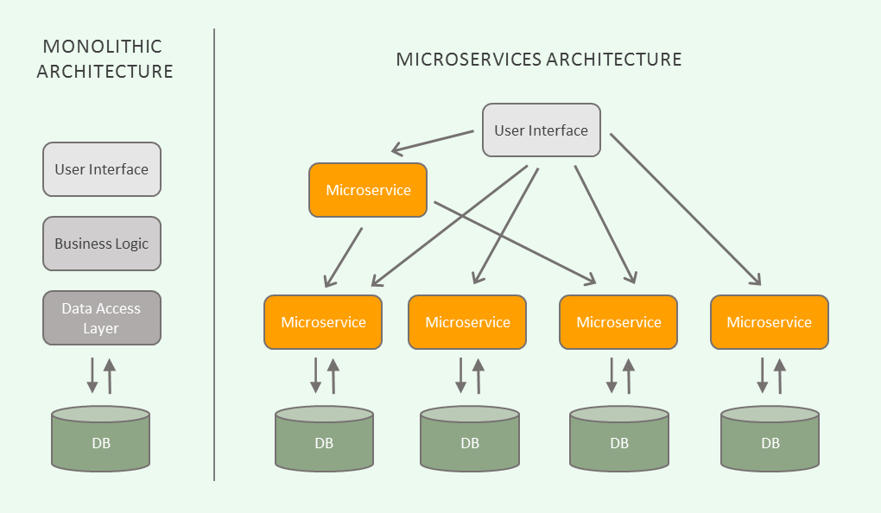
The Idea of Microservices
Source: https://blog.algorithmia.com/introduction-to-microservices/

Slide 8
The Idea Of Microservices
Multiple and small web services
No Monolithic Architecture
Independent web services are easy to manage
Standalone Web Services are scalable on Cloud Platform (or via Docker Containers)

Slide 9
What We Achieve?
Instead of a monolithic architecture, developers can be divided with independent microservices
All the applications will be standalone, easy to scale
No time lost for heavy configuration
Fast start

Slide 10
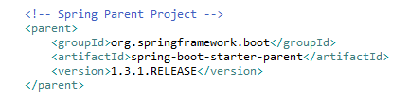
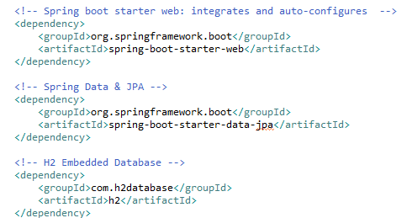
How To Start A Spring Boot Project
All we have to do is add a parent dependency
The we add the starter dependencies

Slide 11
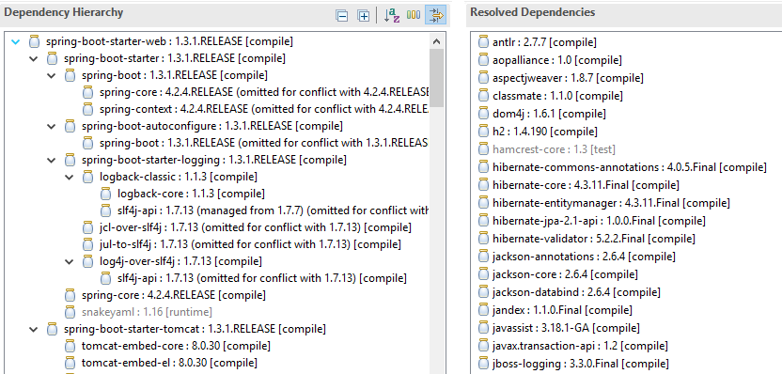
Dependencies
Spring Boot handles what you need

Slide 12
Dependencies
We don’t need to know whether our dependencies are compatible with each other
Dependency compatibility is managed by Spring Boot
No versioning checks are needed for the dependencies

Slide 13
Q&A
Questions
Case Study: Consultant-API

